Slide 1

Inter-net Routing
Soheil Abbasloo
Department of Computer Science
University of Toronto
Fall 2022

Slide 2
Last Time
Least-cost path routing
link-state routing
Each node knows the entire map of network
Each node calculates the routes to all destinations by itself
distance-vector routing
Each node only knows its neighbors and their distance to destinations
Calculations happen in a distributed fashion
Slow convergence

Slide 3
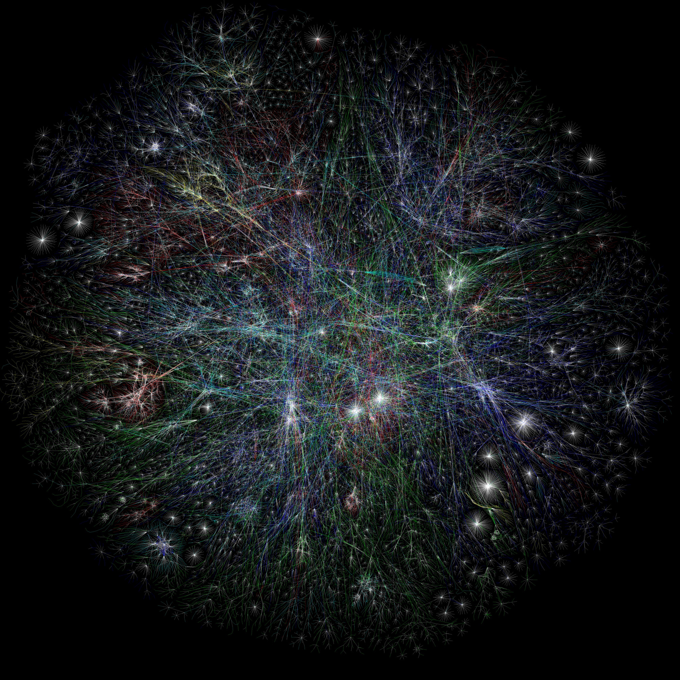
Which one do you think is a better choice for this network?
(Today) Routing in the Internet

Slide 4
To see how routing is done on the Internet first, let’s look at the Internet topology
Internet Topology
Routing in the Internet

Slide 5
The Internet is a network of networks, referred to as Autonomous Systems (AS) ASes are sometimes called “domains”

Slide 6
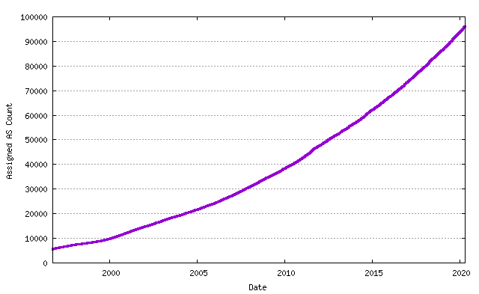
Autonomous Systems (AS)
AS is a network under a single administrative control
currently over 90,000 assigned ASes
Each AS is assigned a unique identifier
Previously 16 bit AS Number (ASN)
as of 2006, it is a 32-bit number
E.g., ASN 239 is UofT
https://www.potaroo.net/tools/asn32/

Slide 7
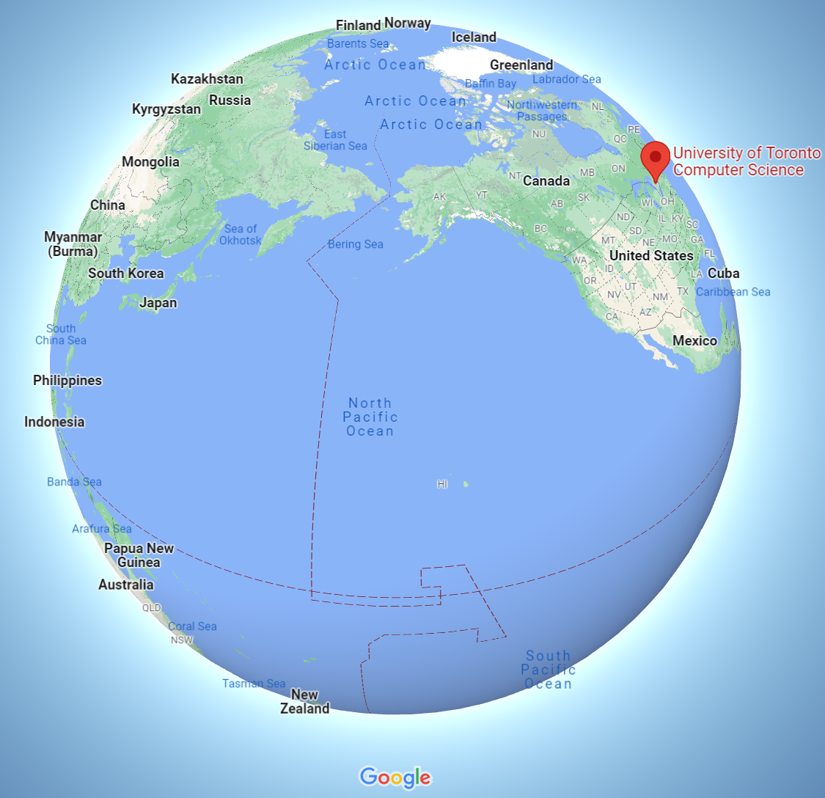
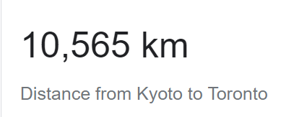
Recall the Uoft – Kyoto example …
Soheil@ Home on Bell Network > traceroute –f 4 -q1 istc.doshisha.ac.jp
traceroute to istc.doshisha.ac.jp (202.23.190.159), 30 hops max,
5 tcore4-toronto12_37.net.bell.ca (64.230.59.200) 24.838 ms
6 cr01-mtrlpq01h33_bundle-ether9.net.bell.ca (142.124.127.231) 19.103 ms
7 tcore4-montreal02_bundle-ether57.net.bell.ca (142.124.127.250) 26.140 ms
8 tcore4-newyorkaa_hundredgige0-3-0-0.net.bell.ca (64.230.79.144) 24.725 ms
9 bx7-newyork83_hundredgige0-7-0-0.net.bell.ca (64.230.79.91) 23.612 ms
10 NYIIX.IIJ.Net (198.32.160.42) 27.037 ms
11 nyc002bb00.IIJ.Net (58.138.81.49) 29.022 ms
12 sea001bb00.IIJ.Net (58.138.81.58) 73.050 ms
13 tky009bb00.IIJ.Net (58.138.88.225) 156.554 ms
14 tky009ix50.IIJ.Net (58.138.114.230) 167.123 ms
15 202.232.6.18 (202.232.6.18) 162.362 ms
16 150.99.18.34 (150.99.18.34) 192.893 ms
17 doshisha-LAN.gw.sinet.ad.jp (150.99.196.66) 189.294 ms
18 *
Kyoto
Packets went through different ASes

Slide 8
Internet: a Network of Networks
Two different routing philosophies
“Intra-net” routing : routing within an AS
“Inter-net” routing: routing between ASes
Within Bell network
5 tcore4-toronto12_37.net.bell.ca (64.230.59.200) 24.838 ms
6 cr01-mtrlpq01h33_bundle-ether9.net.bell.ca (142.124.127.231) 19.103 ms
7 tcore4-montreal02_bundle-ether57.net.bell.ca (142.124.127.250) 26.140 ms
8 tcore4-newyorkaa_hundredgige0-3-0-0.net.bell.ca (64.230.79.144) 24.725 ms
bx7-newyork83_hundredgige0-7-0-0.net.bell.ca (64.230.79.91) 23.612 ms
b.w. Bell and IIJ
networks
9 bx7-newyork83_hundredgige0-7-0-0.net.bell.ca (64.230.79.91) 23.612 ms
-----------------------------------------------------
11 nyc002bb00.IIJ.Net (58.138.81.49) 29.022 ms

Slide 9
“Intra-net” routing: within an AS
Network operators don’t want arbitrary paths, they want good paths
“least cost” paths
Convergence
Link-State (OSPF) and Distance-Vector (RIP, IGRP)

Slide 10
“Inter-net” routing: between ASes
Inter-net routing is not about “least cost” paths!
Main challenge
Administrative structure
Issues of autonomy, policy, privacy

Slide 11
Administrative structure shapes Inter-net routing
ASes want freedom to pick routes based on policy
“My traffic can’t be carried over my competitor’s network”
“I don’t want to carry A’s traffic through my network”
Not expressible as Internet-wide “least cost”!
ASes want autonomy
Want to choose their own internal routing protocol
Want to choose their own policy
ASes want privacy
choice of network topology, routing policies, etc.
“I don’t want my rival to know my internal topology”

Slide 12
Choice of Routing Algorithm
Link State (LS) vs. Distance Vector (DV)?
LS offers no privacy – broadcasts all network information
LS limits autonomy -- need agreement on metric, algorithm
DV is a decent starting point
Per-destination updates by intermediate nodes give us a hook
but wasn’t designed to implement policy
and is vulnerable to loops if shortest paths not taken
The “Border Gateway Protocol” (BGP) extends distance-vector ideas to accommodate policy

Slide 13
BGP

Slide 14
Outline
The role of policy
what we mean by it
why we need it
Overall approach
four non-trivial changes to DV
how policy is implemented (detail-free version)

Slide 15
Administrative structure shapes Interdomain routing
ASes want freedom to pick routes based on policy
ASes want autonomy
ASes want privacy

Slide 16
Topology and policy is shaped by the business relationships between ASes
Three basic kinds of relationships between ASes
AS A can be AS B’s customer
AS A can be AS B’s provider
AS A can be AS B’s peer
Business implications
Customer pays provider
Peers don’t pay each other
Exchange roughly equal traffic
Notes:
Ehy???

Slide 17
Business Relationships
Relations between ASes
Business Implications
Customers pay provider
Peers don’t pay each other
provider
customer
peer
peer

Slide 18

Why peer?
A
E.g., D and E talk a lot
B
C
Peering saves B and C money
D
E
Relations between ASes
Business Implications
Customers pay provider
Peers don’t pay each other
provider
customer
peer
peer

Slide 19
Routing Follows the MONEY!
Pr
Cu
Q
Peer
Peer
A
B
C
D
E
F
traffic allowed
traffic not allowed
ASes provide “transit” between their customers
Peers do not provide transit between other peers

Slide 20
Routing Follows the MONEY!
Pr
Cu
Q
Peer
Peer
A
B
C
D
E
F
An AS only carries traffic to/from its own customers over a peering link

Slide 21
Routing Follows the MONEY!
Pr
Cu
Peer
Peer
C
A
F
Routes are “valley free”

Slide 22
In Short
AS topology reflects business relationships between Ases
Business relationships between ASes impact which routes are acceptable
BGP Policy: Protocol design that allows ASes to control which routes are used

Slide 23
BGP
The role of policy
what we mean by it
why we need it
Overall approach
four non-trivial changes to DV
how policy is implemented (detail-free version)

Slide 24
Inter-net Routing: Setup
Destinations are IP prefixes (12.0.0.0/8)
Nodes are Autonomous Systems (ASes)
Internals of each AS are hidden
Links represent both physical links and business relationships
BGP (Border Gateway Protocol) is the Inter-domain routing protocol
Implemented by AS border routers

Slide 25
BGP: Basic Idea
An AS advertises (“exports”) its best routes to one or more IP prefixes
Each AS selects the “best” route it hears advertised for a prefix
You’ve heard this story before!
Notes:
Arrows are routing message

Slide 26
BGP inspired by Distance Vector
Per-destination route advertisements
No global sharing of network topology information
Iterative and distributed convergence on paths
With four crucial differences!

Slide 27
Differences between BGP and DV (1) not picking shortest path routes
BGP selects the best route based on policy, not shortest distance (least cost)
How do we avoid loops?
2
3
Node 2 may prefer “2, 3, 1” over “2, 1”
1

Slide 28
Differences between BGP and DV (2) path-vector routing
Key idea: advertise the entire path
Distance vector: send distance metric per dest d
Path vector: send the entire path for each dest d
“d: path (B,A)”
“d: path (A)”
C
B
A
data traffic
data traffic
d

Slide 29
Differences between BGP and DV (2) path-vector routing
Key idea: advertise the entire path
Distance vector: send distance metric per destination
Path vector: send the entire path for each destination
Benefits
loop avoidance is easy

Slide 30
Loop Detection with Path-Vector
Node can easily detect a loop
Look for its own node identifier in the path
Node can simply discard paths with loops
E.g., node 1 sees itself in the path “3, 2, 1”
E.g., node 1 simply discards the advertisement
“d: path (2,1)”
“d: path (1)”
3
2
1
d
“d: path (3,2,1)”

Slide 31
Differences between BGP and DV (2) path-vector routing
Key idea: advertise the entire path
Distance vector: send distance metric per destination
Path vector: send the entire path for each destination
Benefits
loop avoidance is easy
flexible policies based on entire path

Slide 32
Differences between BGP and DV (3) Selective route advertisement
For policy reasons, an AS may choose not to advertise a route to a destination
Hence, reachability is not guaranteed even if graph is connected
AS1
AS3
AS2 does not want to carry traffic between AS1 and AS3!
AS2

Slide 33
Differences between BGP and DV (4) BGP may aggregate routes
For scalability, BGP may aggregate routes for different prefixes
a.*.*.* is this way
Bell a.0.0.0/8
Waterloo a.d.0.0/16
foo a.b.0.0/16
UofT a.c.0.0/16

Slide 34
BGP
The role of policy
what we mean by it
why we need it
Overall approach
four non-trivial changes to DV
how policy is implemented (detail-free version)

Slide 35
Policy imposed in how routes are selected and exported
Route export
Route selection
Customer
1
Can reach 128.3/16
blah blah
10
Competitor
5
Selection: Which path to use?
controls whether/how traffic leaves the network
Export: Which path to advertise?
controls whether/how traffic enters the network
Notes:
Arrows: routing messages!

Slide 36
Typical Selection Policy
In decreasing order of priority
make/save money (send to customer > peer > provider)
maximize performance (smallest AS path length)
minimize use of my network bandwidth (“hot potato”)
…
…
BGP uses something called route “attributes” to implement the above (coming next!)

Slide 37
Typical Export: Peer-Peer Case
Peers exchange traffic between their customers
AS exports only customer routes to a peer
AS exports a peer’s routes only to its customers
providers
advertisements
peer
peer
traffic
d
customers

Slide 38
Typical Export: Customer-Provider
Customer pays provider for access to Internet
Provider exports its customer routes to everybody
Customer exports provider routes only to its customers
Traffic to customer
Traffic from customer
d
provider
advertisements
provider
traffic
customer
d
customer

Slide 39
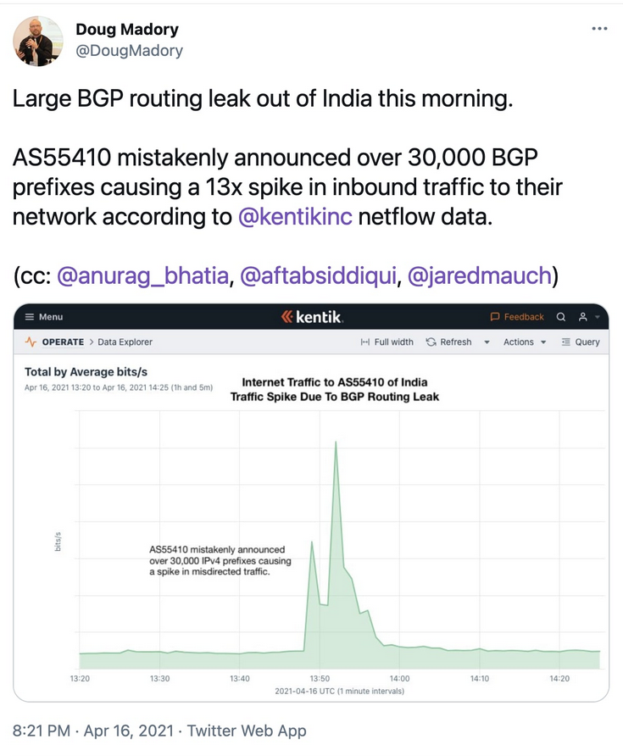
Wrong advertisements have serious impacts!
“although the BGP routing leak occurred in Vodafone's autonomous network (AS 55410) based in India, it has impacted U.S. companies, including Google”
“… the network mistakenly advertising that it supported over 30,000 BGP prefixes or routes, when it didn't, causing the internet to flood this network with traffic that was not meant to go through it”
https://www.bleepingcomputer.com/news/security/major-bgp-leak-disrupts-thousands-of-networks-globally/

Slide 40
Next
BGP protocol details
stay awake as long as you can …

Slide 41
Who speaks BGP?
Border router
Internal router
Border routers at an Autonomous System
Notes:
Say “There are four parts to internet routing” (don’t say in route selection)

Slide 42
What does “speak BGP” mean?
Implement the BGP protocol standard
read more here: http://tools.ietf.org/html/rfc4271
Specifies what messages to exchange with other BGP “speakers”
message types (e.g., route advertisements, updates)
message syntax
And how to process these messages
e.g., “when you receive a BGP update, do…. “
follows BGP state machine in the protocol spec + policy decisions, etc.

Slide 43
BGP “sessions”
“eBGP session”
A border router speaks BGP with border routers in other ASes
Notes:
Say “There are four parts to internet routing” (don’t say in route selection)

Slide 44
BGP “sessions”
“iBGP session”
A border router speaks BGP with other (interior and border) routers in its own AS
Notes:
Say “There are four parts to internet routing” (don’t say in route selection)

Slide 45
eBGP, iBGP, IGP
eBGP: BGP sessions between border routers in different ASes
Learn routes to external destinations
iBGP: BGP sessions between border routers and other routers within the same AS
distribute externally learned routes internally
IGP: “Interior Gateway Protocol” = Intradomain routing protocol
provide internal reachability
e.g., OSPF, RIP

Slide 46
Some Border Routers Don’t Need BGP
Customer that connects to a single upstream ISP
The ISP can advertise prefixes into BGP on behalf of customer
… and the customer can simply default-route to the ISP
Provider
Install routes 130.132.0.0/16 pointing to Customer
Install default routes pointing to Provider
Customer
130.132.0.0/16

Slide 47
Putting the pieces together
3
2
2
6
4
9
3
1
Provide internal reachability (IGP)
Learn routes to external destinations (eBGP)
Distribute externally learned routes internally (iBGP)
Travel shortest path to egress (IGP)

Slide 48
Basic Messages in BGP
Open
Establishes BGP session
BGP uses TCP [will make sense in 1-2weeks]
Notification
Report unusual conditions
Update
Inform neighbor of new routes
Inform neighbor of old routes that become inactive
Keepalive
Inform neighbor that connection is still viable

Slide 49
Route Updates
Format <IP prefix: route attributes>
attributes describe properties of the route
Two kinds of updates
announcements: new routes or changes to existing routes
withdrawal: remove routes that no longer exist

Slide 50
Route Attributes
Routes are described using attributes
Used in route selection/export decisions
Some attributes are local
i.e., private within an AS, not included in announcements
Some attributes are propagated with eBGP route announcements
There are many standardized attributes in BGP
We will discuss a few

Slide 51
Attributes (1): ASPATH
Carried in route announcements
Vector that lists all the ASes a route advertisement has traversed (in reverse order)
AS 577
Bell Canada
AS 239
AS 12654
UofT, 128.100/16
IP prefix = 128.100.0.0/16
AS path = 239
IP prefix = 128.100.0.0/16
AS path = 577 239

Slide 52
Attributes (2): LOCAL PREF
“Local Preference”
Used to choose between different AS paths
The higher the value the more preferred
Local to an AS; carried only in iBGP messages
140.20.1.0/24
BGP table at AS4:
AS1
AS2
AS3
AS4
Notes:
Because communicated to all IBGP routers within AS, all routers have a common view of how to exit the AS.
This differs from MED in 2 ways: (1) the destination prefix can be anywhere in the internet, not just in the next AS (as in the case for MED). (2) the AS that sets Local_Pref, is also the one that uses it. This allows one node to tell everyone locally what the best way out is.
MED can’t be used in this example because there is exactly one connection between any pair of AS’s.

Slide 53
Attributes (3) : MED
“Multi-Exit Discriminator”
Used when ASes are interconnected via 2 or more links to specify how close a prefix is to the link it is announced on
Lower is better
AS announcing prefix sets MED
AS receiving prefix (optionally!) uses MED to select link
AS1
Link B
Link A
MED=50
MED=10
AS2
AS3
destination prefix

Slide 54

Attributes (4): IGP cost
Used for hot-potato routing
Each router selects the closest egress point based on the path cost in intra-domain protocol
dst
9
B
A
B
A
D
4
3
8
10
4
3
G
F
5
8
E
C

Slide 55
Typical Selection Policy
In decreasing order of priority
make/save money (send to customer > peer > provider)
maximize performance (smallest AS path length)
minimize use of my network bandwidth (“hot potato”)
…
…

Slide 56
Using Attributes
Rules for route selection in priority order (Gao-Rexford rec.)
Priority | Rule | Remarks
1 | LOCAL PREF | Pick highest LOCAL PREF
2 | ASPATH | Pick shortest ASPATH length
3 | MED | Lowest MED preferred
4 | eBGP > iBGP | Did AS learn route via eBGP (preferred) or iBGP?
5 | iBGP path | Lowest IGP cost to next hop (egress router)
6 | Router ID | Smallest next-hop router’s IP address as tie-breaker

Slide 57
BGP UPDATE Processing
Constrained only by vendor configuration language
Control plane
BGP
Updates
BGP
Updates
Apply Import
Policies
Best Route
Selection
Best Route
Table
Apply Export
Policies
Data plane
forwarding
Entries
Data packets
Data packets
IP Forwarding Table

Slide 58
BGP issues

Slide 59
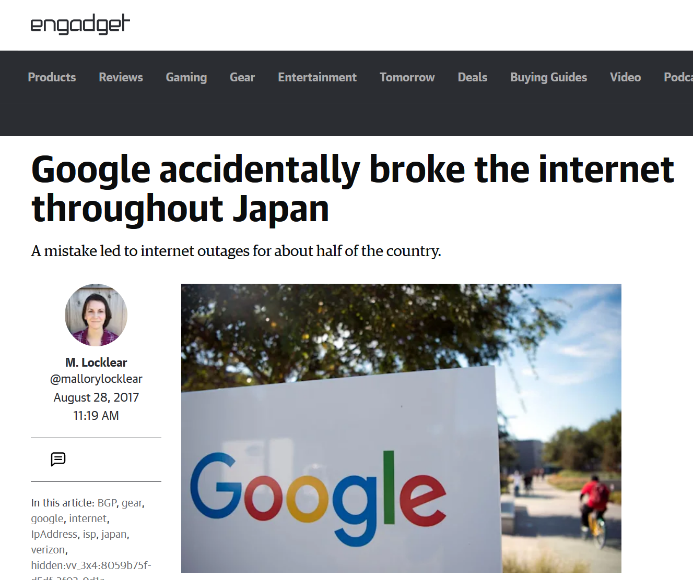
BGP Issues and their Serious Consequences!
“Someone in Google fat-thumbed a
Border Gateway Protocol (BGP) advertisement
and sent Japanese Internet traffic into a black hole.”

Slide 60
Issues with BGP
Reachability
Security
Convergence
Performance
Anomalies

Slide 61
Reachability
In normal routing, if graph is connected then reachability is assured
With policy routing, this does not always hold
AS 1
AS 3
Provider
Provider
AS 2
Customer

Slide 62
Security
An AS can claim to serve a prefix that they actually don’t have a route to (blackholing traffic)
Problem not specific to policy or path vector
Important because of AS autonomy
Fixable: make ASes “prove” they have a path
Note: AS may forward packets along a route different from what is advertised
Tell customers about fictitious short path…
Much harder to fix!

Slide 63
Convergence
If all AS policies follow rules discussed (Gao-Rexford rec.), BGP can be shown to converge (safety)
For arbitrary policies, BGP may fail to converge!

Slide 64
Example of Policy Oscillation
“1” prefers “1 3 0”
over “1 0” to reach “0”
1 3 0
1 0
1
0
2 1 0
2 0
3 2 0
3 0
2
3

Slide 65
Step-by-Step of Policy Oscillation
Initially: nodes 1, 2, 3 know only shortest path to 0
1 3 0
1 0
1
0
2 1 0
2 0
3 2 0
3 0
2
3

Slide 66
1 advertises its path 1 0 to 2
1 3 0
1 0
1
advertise: 1 0
0
2 1 0
2 0
3 2 0
3 0
2
3

Slide 67
1 3 0
1 0
1
0
2 1 0
2 0
3 2 0
3 0
2
3

Slide 68
3 advertises its path 3 0 to 1
1 3 0
1 0
1
advertise: 3 0
0
2 1 0
2 0
3 2 0
3 0
2
3

Slide 69
Step-by-Step of Policy Oscillation
1 3 0
1 0
1
0
2 1 0
2 0
3 2 0
3 0
2
3

Slide 70
1 withdraws its path 1 0 from 2
1 3 0
1 0
1
withdraw: 1 0
0
2 1 0
2 0
3 2 0
3 0
2
3

Slide 71
1 3 0
1 0
1
0
2 1 0
2 0
3 2 0
3 0
2
3

Slide 72
2 advertises its path 2 0 to 3
1 3 0
1 0
1
0
2 1 0
2 0
3 2 0
3 0
2
3
advertise: 2 0

Slide 73
1 3 0
1 0
1
0
2 1 0
2 0
3 2 0
3 0
2
3

Slide 74
3 withdraws its path 3 0 from 1
1 3 0
1 0
1
withdraw: 3 0
0
2 1 0
2 0
3 2 0
3 0
2
3

Slide 75
1 3 0
1 0
1
0
2 1 0
2 0
3 2 0
3 0
2
3

Slide 76
1 advertises its path 1 0 to 2
1 3 0
1 0
1
advertise: 1 0
0
2 1 0
2 0
3 2 0
3 0
2
3

Slide 77
1 3 0
1 0
1
0
2 1 0
2 0
3 2 0
3 0
2
3

Slide 78
2 withdraws its path 2 0 from 3
1 3 0
1 0
1
0
2 1 0
2 0
3 2 0
3 0
2
3
withdraw: 2 0

Slide 79
1 3 0
1 0
1
0
2 1 0
2 0
3 2 0
3 0
2
3
We are back to where we started!

Slide 80
Convergence
For arbitrary policies, BGP may fail to converge!
Why should this trouble us?

Slide 81
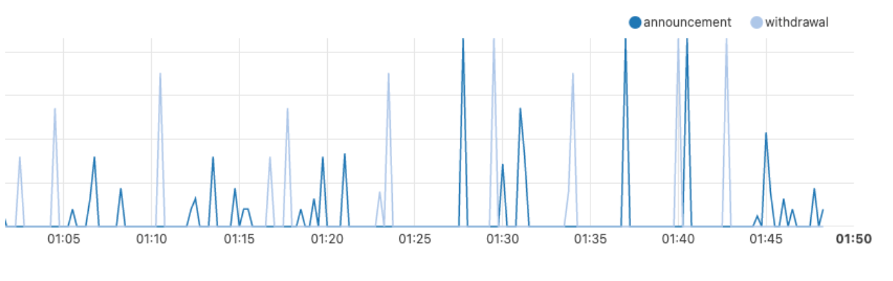
Real World Example: BGP Issue at Rogers (July 2022) Frequent Announcements and Withdrawals
*https://blog.cloudflare.com/cloudflares-view-of-the-rogers-communications-outage-in-canada/

Slide 82
Performance Nonissues
Internal routing (non)
Domains typically use “hot potato” routing
Not always optimal, but economically expedient
Policy not about performance (non)
So policy-chosen paths aren’t shortest
AS path length can be misleading (non)
20% of paths inflated by at least 5 router hops
Notes:
Lesson: not being optimal: who cares
Not being connected: we all care!!

Slide 83
Performance (example)
AS path length can be misleading
An AS may have many router-level hops
BGP says that path 4 1 is better than path 3 2 1
AS 4
AS 3
AS 2
AS 1

Slide 84
BGP Misconfigurations
BGP protocol is both bloated and underspecified
lots of attributes
lots of leeway in how to set and interpret attributes
necessary to allow autonomy, diverse policies
but also gives operators plenty of rope
Much of this configuration is manual and ad hoc
And the core abstraction is fundamentally flawed!
disjoint per-router configuration to effect AS-wide policy
now strong industry interest in changing this!
Notes:
Lesson: not being optimal: who cares
Not being connected: we all care!!

Slide 85
BGP: How did we get here?
1989 : BGP-1 [RFC 1105]
Replacement for EGP (1984, RFC 904)
1990 : BGP-2 [RFC 1163]
1991 : BGP-3 [RFC 1267]
1995 : BGP-4 [RFC 1771]
Support for Classless Interdomain Routing (CIDR)
BGP was designed for a different time!
before commercial ISPs and their needs
before address aggregation
We don’t get a second chance: `clean slate’ designs virtually impossible to deploy
Thought experiment: how would you design a policy-driven interdomain routing solution? How would you deploy it?
Notes:
Lesson: not being optimal: who cares
Not being connected: we all care!!

Slide 86
Next Time: Transport Layer

